Slide 1
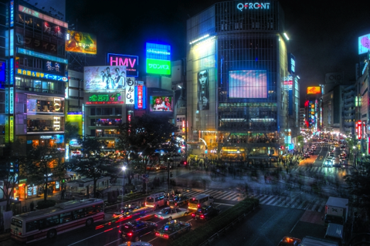
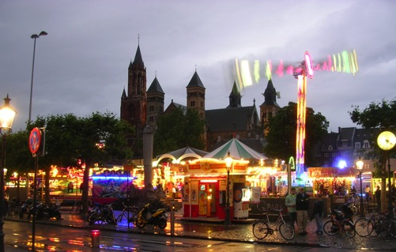
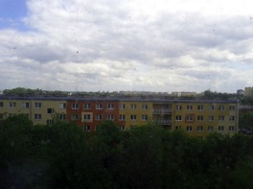
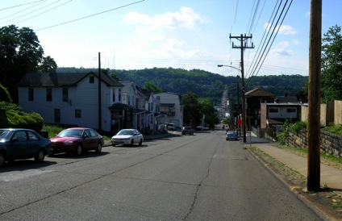
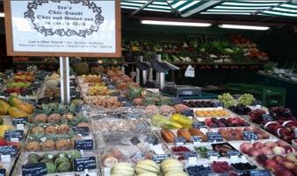
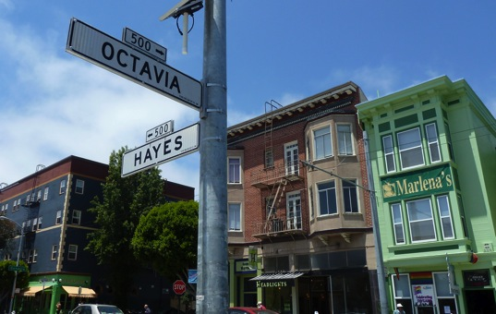
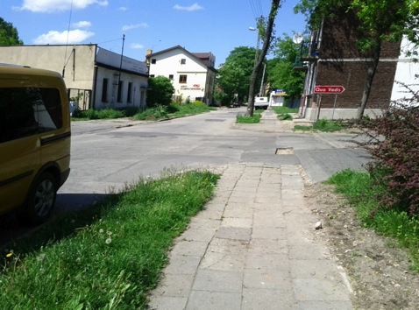
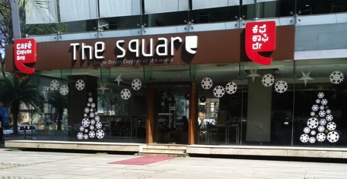
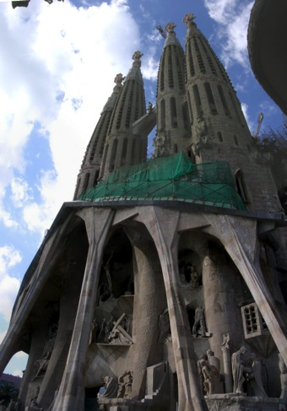
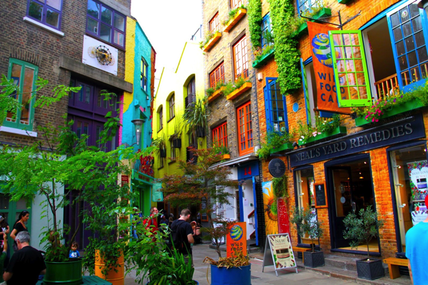
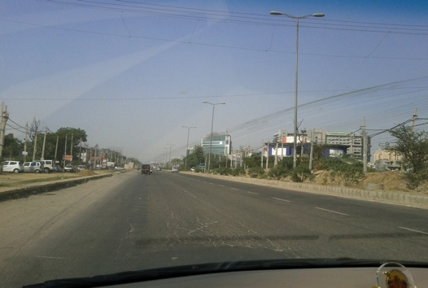
Rock Candy World

Slide 2
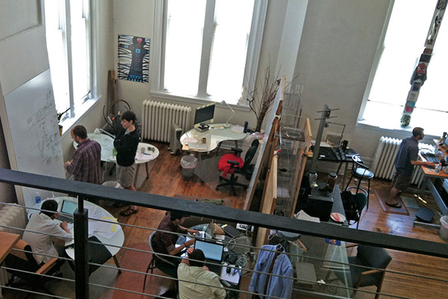
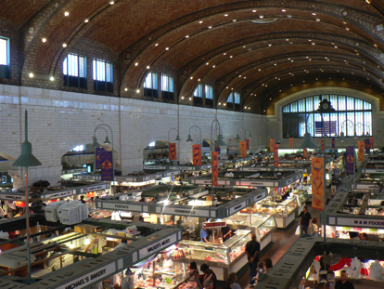
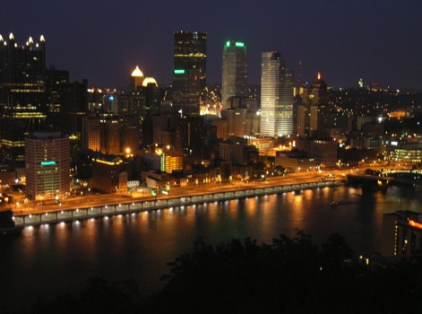
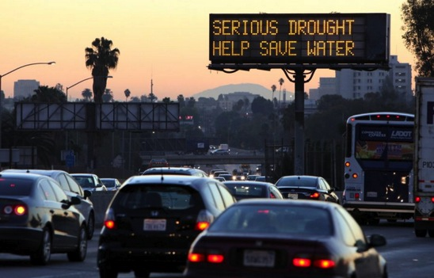
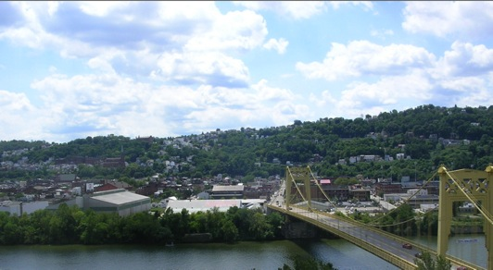
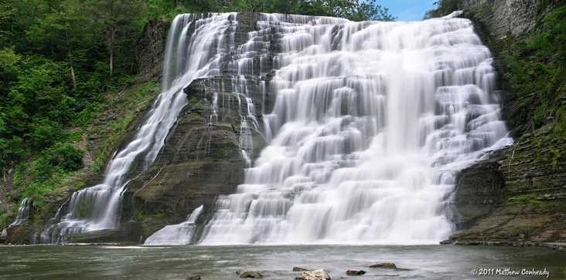
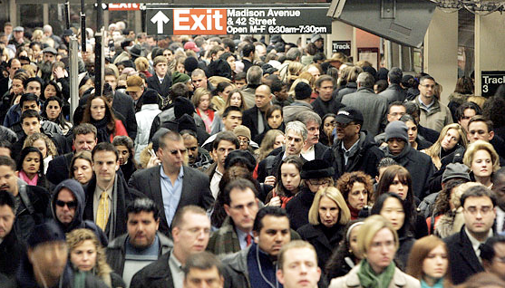
Leapfrog Cities

Slide 3
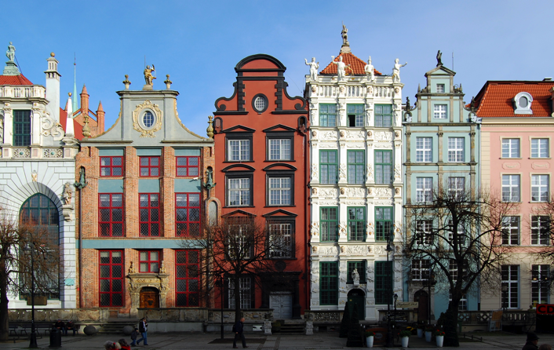

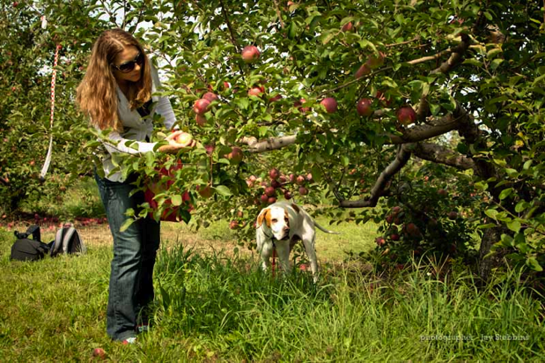
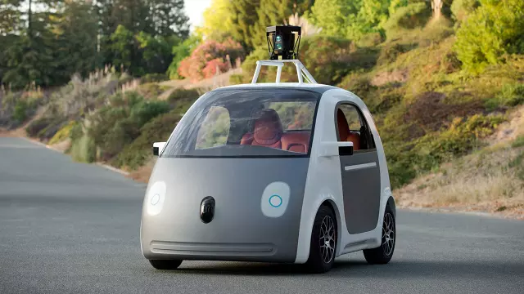
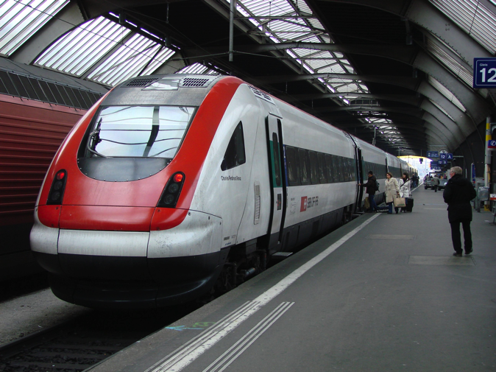

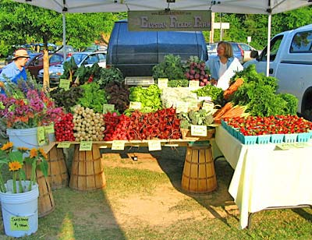
The Age of Great Mini-Mobility

Slide 4
Photo credits: (all uncredited images are personal photos)
Rock Candy World
Shibuya: http://upload.wikimedia.org/wikipedia/commons/4/4e/Shibuya_Night_(HDR).jpg
Octavia and Hayes: http://www.destinationtba.com/wp-content/uploads/2011/06/P1040260.jpg
Neal's Yard: http://stories.eurostar.com/wp-content/uploads/2014/04/IMG_0895.jpg
Leapfrog Cities
People in subway: http://blog.g8-life.com/2011/10/world-population-reaches-7-billion.html
Ithaca falls: http://nyfalls.com/dev/wp-content/uploads/2013/02/Ithaca-Falls-Gallery-01.jpg
Serious drought cars: http://nextcity.org/daily/entry/drought-west-california-water-selling
Pittsburgh coworking space: http://www.popcitymedia.com/features/sharedworkspaces0821.aspx
Age of Great Mini-Mobility
Swiss train: http://4rail.net/ch/sbb-icn-zurich-311207.jpg
Google car: http://www.fastcodesign.com/3031342/top-car-designers-critique-googles-cute-self-driving-car
Boy listening to music: http://www.corbisimages.com/images/Corbis-42-18769681.jpg?size=67&uid=31a68ad5-0119-43a0-97b1-7e706720e7e9
Family reunion: http://s.hswstatic.com/gif/5-family-reunion-games-1.jpg
Apple picking: http://fidoloves.com/wp-content/uploads/2011/09/apple-picking-dogs-allowed.jpg
Farm stand: http://exploremiamisburg.com/wp-content/uploads/2011/06/farmers-market.jpg

